Slide 1






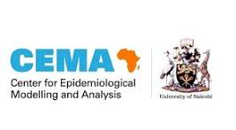

Improving Treatment Outcome in Drug-Resistant Tuberculosis: Predictive Insights from Makueni County, Kenya
Benedict M. Muma^{1*}, Stephen Mwatha¹, Caroline Kaeni¹, Joseph Mulei¹, Alphonce J. Mutinda¹, Emmaculate W. Kyalo², Edwin Mutendwa³, Purity W. Nyaikamba⁴, Vincent Kongo⁴, George P. Omondi⁴, Mutono Nyamai⁴
1: Makueni County, Department of Health Services 2: Nairobi City County 3: Ministry of Health, Kenya 4: Centre for Epidemiological Modeling & Analysis
Thematic Area: Public health interventions towards Universal Health Coverage.
Kenya Health Security Convention | 5th – 8th May 2026 | Mombasa - Kenya

Slide 2
Background
  DR‑TB accounts for 13% of antimicrobial resistance deaths globally
  10.8 million TB cases and 1.25 million deaths in 2023 (WHO)
  400,000 MDR/RR‑TB cases reported worldwide in 2023
  Kenya DR‑TB prevalence: 1.5%, among 30 high‑burden countries
  East Africa: 4% prevalence in new cases, 21% in retreatment cases
  Makueni County: 132 DR‑TB cases (2015–2024)
  More than half of cases remain undiagnosed → silent transmission
  Study aim: Develop transmission‑dynamics and predictive models

Slide 3
Objectives
  To develop and validate a compartmental transmission-dynamics model adapting the SEIR framework to simulate the intervention cascade, treatment outcome dynamics, and transmission patterns of drug-resistant tuberculosis in Makueni County
  To construct and evaluate machine learning-based predictive models using sociodemographic and clinical characteristics to identify patients at high risk of poor treatment outcomes and inform early intervention strategies for drug-resistant tuberculosis management in Makueni County

Slide 4
Methodology
  Study Design: Retrospective review of 132 drug‑resistant TB cases from the national TIBU register (2015–2024)
  Study area: Makueni County
  Sampling: Census approach ensured inclusion of all documented cases in Makueni County
  Data Collected: Demographics (age, sex, residence) and clinical variables (BMI, HIV status, resistance subtype, GeneXpert results, treatment outcomes)
  Confidentiality: Patient identifiers excluded during abstraction and analysis
  Analysis Tools: R
  Systems Modeling: Applied SEIR-P framework to simulate intervention cascades, treatment trajectories, and transmission dynamics.
  ML models: Logistic Regression, Random Forest, SVM, KNN, GBM, XGBoost, Neural Networks

Slide 5
Methodology
  Model Evaluation: Compared training/testing accuracy; assessed sensitivity, specificity, PPV, NPV, Cohen’s Kappa, and AUC
  Feature Importance: Tuned Logistic Regression coefficients used to identify clinically relevant predictors
  Ethics: Approval obtained from relevant authorities; confidentiality strictly maintained
  Limitations: Reliance on hospital‑based records may underrepresent community cases
  Strength: Integration of SEIR modeling and machine learning provided robust, context‑specific evidence for health system strengthening

Slide 6
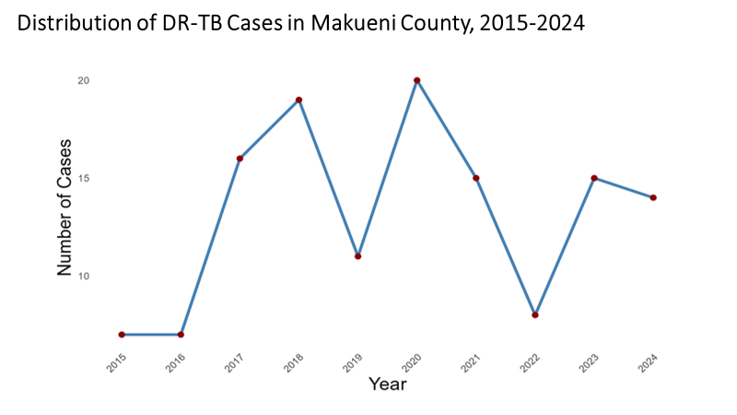
Results

Slide 7
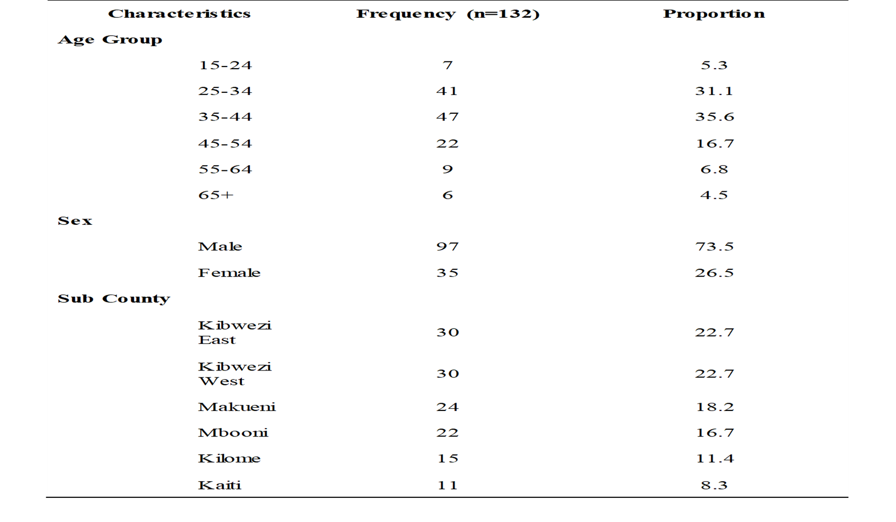
Results
  Sociodemographic background of the DR-TB patients

Slide 8
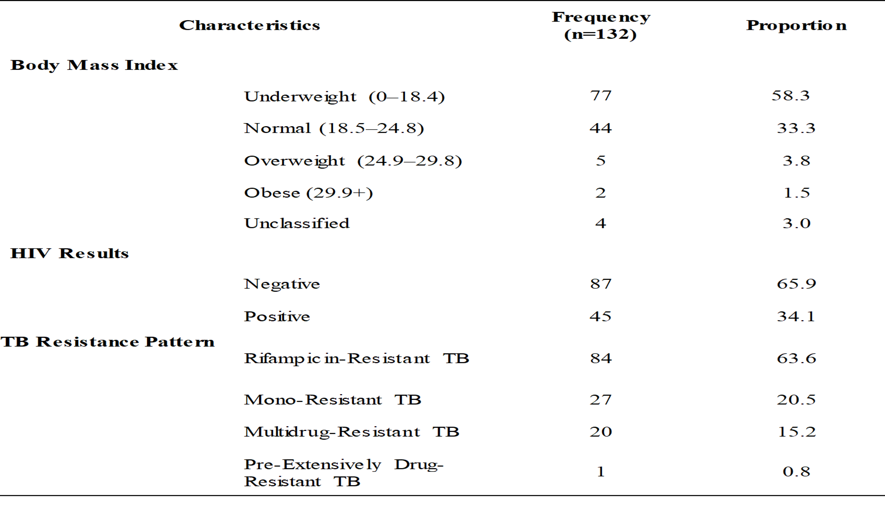
Results
  Clinical Information of the DR-TB patients

Slide 9
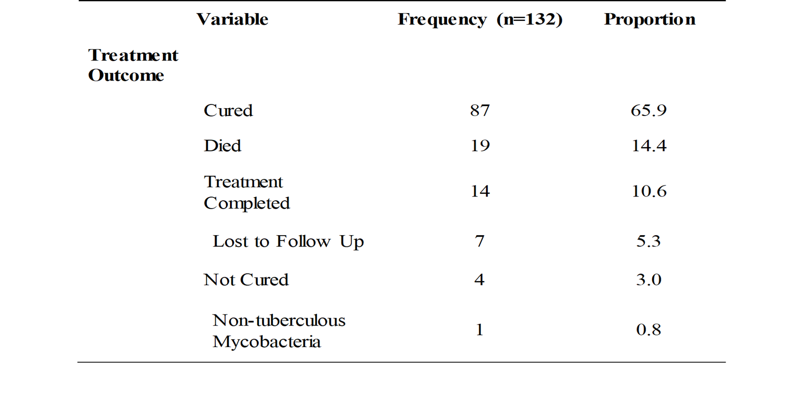
Results
  DR-TB Treatment Outcome

Slide 10
Results
SEIR-P Model Overview
Compartmental SEIR‑P framework
Focus: DR‑TB in Makueni County
Simulation horizon: 720 days (24 months)
  WHO Standard for conventional longer regimens
Seeded with one infectious case to initiate transmission at baseline
Captures progression and treatment outcomes

Slide 11
Results
Compartment Definitions:
S: Susceptible individuals
E: Exposed (latent, not yet infectious)
I: Infectious patients under treatment
R: Recovered with good outcomes
  Aligning with WHO treatment outcome definitions
P: Poor outcomes (death, failure, LTFU)

Slide 12
Results
Initial Conditions
Total county population: 987,653
Susceptible (S₀ = 987,520)
Exposed (E₀ = 0)
Infectious (I₀ = 1)
Recovered (R₀ = 101)
Poor outcome (P₀ = 31)
Baseline recoveries and poor outcomes were incorporated to reflect real program data
Seeding with one infectious case avoids trivial dynamics and mimics early outbreak/epidemic conditions

Slide 13
Results
Parameterization
Parameters informed by local data + literature
β and σ were not directly estimated due to data limitations
  Transmission rate β = 0.2/month
  Progression rate σ = 0.15/month
γ and μ proportions were derived directly from the 132‑patient cohort
  Recovery rate γ = 76.5% (n=101)
  Poor outcome rate μ = 23.5% (n=31)
Mean infectious duration fixed at 720 days to scale hazard rate (adjust transitions)

Slide 14
Results
Assumptions
Fixed population size
  No births/natural deaths/new entries
Homogeneous mixing of individuals
  Every susceptible person has the same chance of contact with any infectious person).
Constant transition hazards
  Transitions occur at a fixed probability per unit time, independent of duration in a compartment
No reinfection after recovery
Poor outcomes treated as absorbing for tractability
  No return to infectiousness
Cohort proportions assumed stable

Slide 15
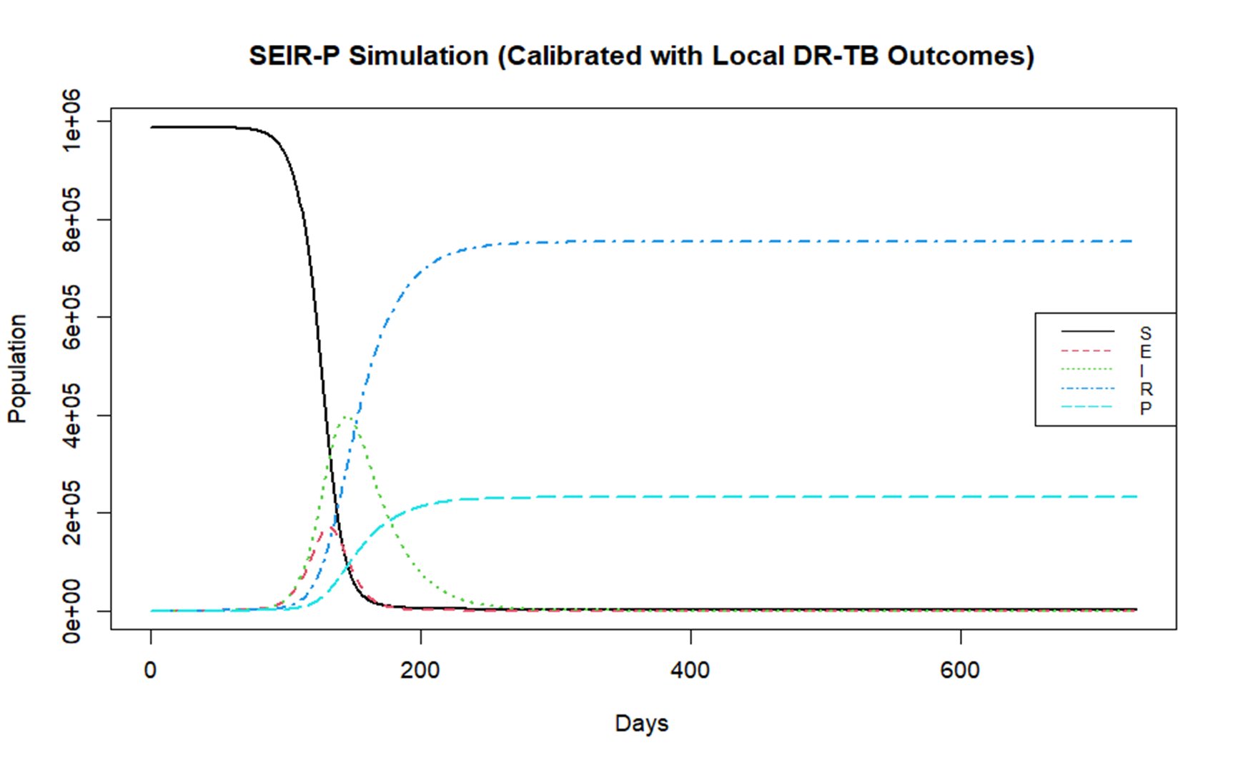
Results

Slide 16
Results
Machine Learning Models:
    Developed multiple models—Logistic Regression, Random Forest, SVM, KNN, GBM, XGBoost, NeuralNetworks
    EDA: Summarize patients outcomes relationships
    Logistic regression for binary outcomes
    Model Training and Evaluation (Metrics): Sensitivity, Specificity, PPV, NPV, Kappa and AUC
    Feature Importance and interpretation: Rank Predictors

Slide 17
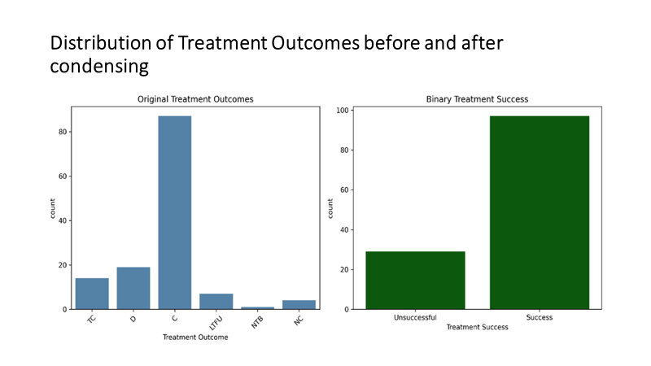
Results

Slide 18
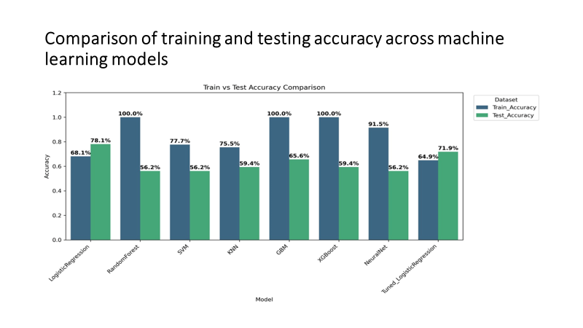
Results

Slide 19
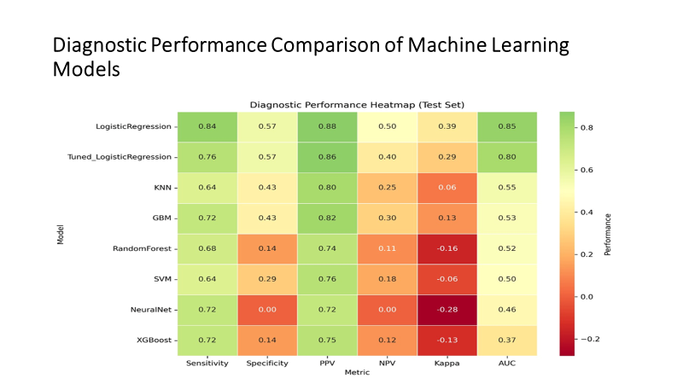
Results

Slide 20
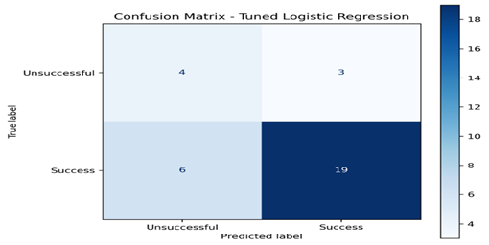
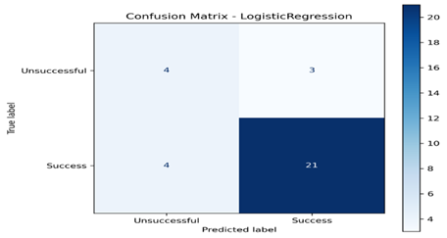
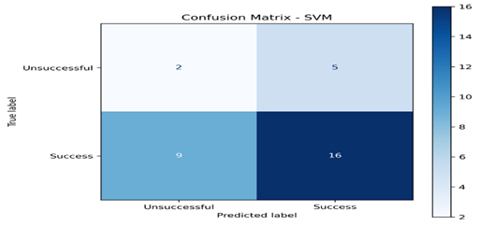
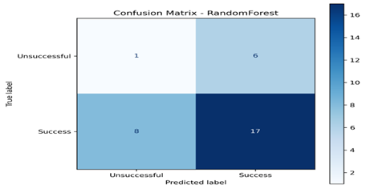
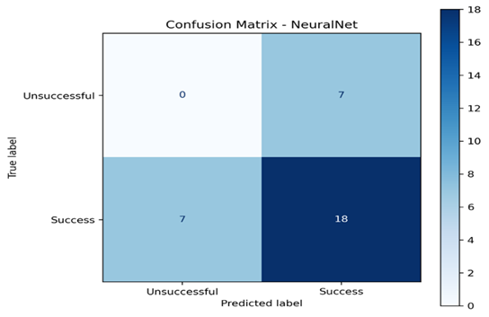
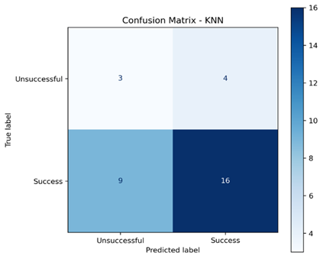

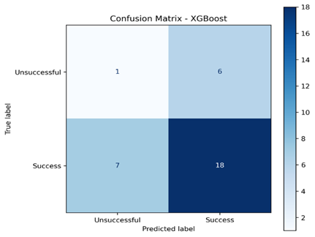
Confusion matrices for logistic regression

Slide 21
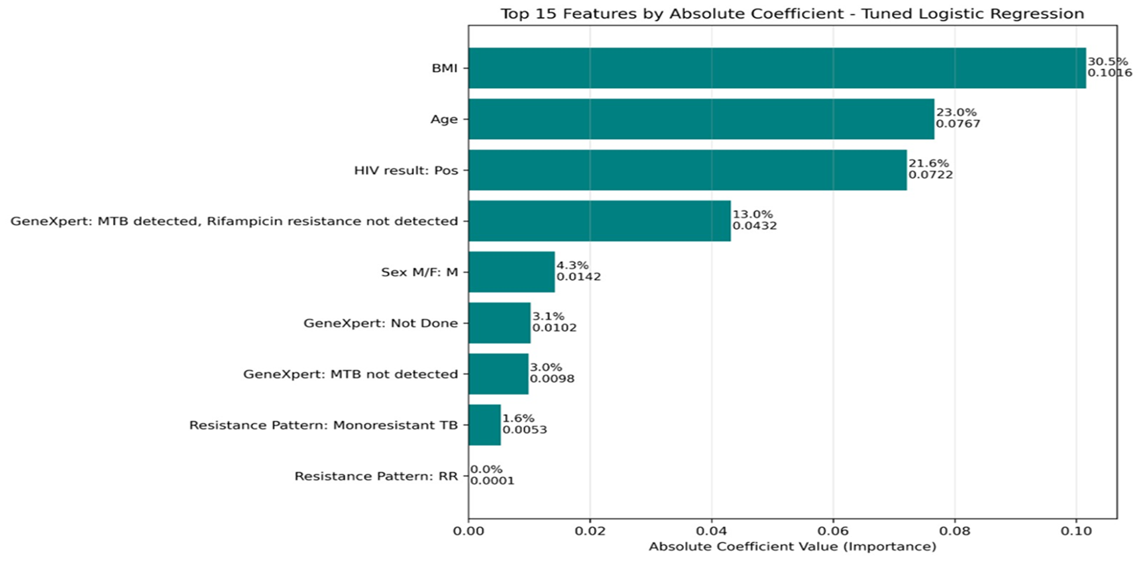
Results: Feature Importance in DR‑TB Treatment Success Model
:

Slide 22
Discussion
  Contextual Evidence: Study provides county‑specific insights on DRTB, complementing global and regional literature
  Treatment Success: Makueni’s rate (76.5%) slightly above WHO minimum (75%) and well above global average (~60%)
  Persistent Gaps: Poor outcomes (23.5%)—deaths and loss to follow‑up—mirror challenges seen in Uganda
  System‑Level Modeling: SEIRP framework shows epidemic wave peaking at 2–4 months
    Policy Implication: Underscores importance of early detection and intervention to flatten epidemic peaks
    Surveillance Needs: High poor outcome rate highlights need for stronger surveillance and targeted interventions
  Machine Learning Insights: Logistic Regression and Tuned Logistic Regression most reliable, balancing accuracy and interpretability
    Feature Importance: BMI, age, and HIV status dominate predictors (>75% of model weight)
    Regional Consistency: Findings align with regional studies linking undernutrition and HIV coinfection to poor TB outcomes
    Policy Alignment: Supports Kenya’s integrated HIV/TB service delivery and nutritional support strategies
    Global Strategy: Reinforces WHO End TB milestones toward 90% success rate by 2035

Slide 23
Conclusion
  DR‑TB remains a major challenge in Makueni County
  Treatment success meets WHO target but poor outcomes persist
  BMI, age, HIV status are critical determinants of success
  SEIR modeling highlights importance of early detection
  Tuned logistic regression offers reliable, interpretable predictive performance

Slide 24
Policy Impact and Implications
  Investing in nutrition: County Government, MoH Nutrition Division and all partners to consistently provide supplements and support community nutrition programs; deploy adequate nutrition officers in all TB treatment sites
  HIV/TB Co‑Management: Tailored ART regimens, stronger supply chains, enhanced monitoring
  Surveillance: Upgrading TIBU, expand community‑level detection
  Predictive Tools: Embed interpretable models in clinical workflows
  Community Engagement: Reduce stigma, strengthen psychosocial support, improve adherence

Slide 25






Thank you!
Scan to visit our website
#KeHSCon2026
@NPHIKenya
www.nphi.go.ke

